Slide 1
Santa Ana Unified School District 2023-2024 Second Interim Report
BOARD PRIORITY: Organizational Efficiency & Effectiveness
March 12, 2024
Notes:
Good evening President Torres, Members of the Board, Superintendent Almendarez, and Education Partners throughout the Santa Ana Community. We are here tonight to deliver the second interim report for the 2023-2024 fiscal year.
When I call out all of our educations partners, this is not just a casual reference.
Tonight’s presentation of the second interim report truly is for everybody.
The budget reports that we present to the Board, at every stage in the budget cycle, are how we demonstrate to the entire Santa Ana community that we are held accountable for proper management of District resources, It is our mission to be as transparent as possible with regard to the revenue that we receive, as well as the

Slide 2
Budget Timeline
Notes:
As we often point out, the Budget team is always working on multiple fiscal years at any given time.
This slide shows the full budget cycle for the current year, as well as the budget development timeline for the 2024-2025 year.
Pause

Slide 3
Budget Timeline
Notes:
…which brings us to the second interim report tonight.
Based on actuals through January 31.
Seven complete months in the fiscal year, and six operational months since the beginning of the school year.
This gives us much better insight into the expenditure patterns year-to-date than we had at first interim, and allows us to fine-tune the projections for the balance of the year.

Slide 4
Interim Budget Reports
Positive Certification
The District WILL meet its financial obligations for the current and two subsequent fiscal years.
Qualified Certification
The District MAY NOT meet its financial obligations for the current or two subsequent fiscal years.
Negative Certification
The District WILL BE UNABLE to meet its financial obligations for the remainder of the current year or for the subsequent fiscal year.
Notes:
Three potential certifications for an interim report related to a district’s ability to meet its financial obligations through the three years of the multiyear projection…

Slide 5
Interim Budget Reports
Positive Certification
The District WILL meet its financial obligations for the current and two subsequent fiscal years.
Qualified Certification
The District MAY NOT meet its financial obligations for the current or two subsequent fiscal years.
Negative Certification
The District WILL BE UNABLE to meet its financial obligations for the remainder of the current year or for the subsequent fiscal year.
Notes:
…and tonight, we are asking the Board to approve a positive certification, which means that we will be able to meet all of our obligations through all three years.

Slide 6
Ending Fund Balance
← Actuals
Projections →
Notes:
As we have done for previous reports, we are starting tonight with the projected multiyear ending fund balance.
I do want to point out now that the projected deficit spending in 2024-2025 and 2025-2026 (the out years) is more steep than it was at first interim.
As we go through the slides, we will discuss how we arrived at these projections.

Slide 7
Official Assumptions
COLA
Decreases in percentages since first interim
ADA
Increases in UPP and attendance factor
PERS
Incremental increases since first interim
Notes:
Here are some of the official assumptions for the second interim report.
COLA for 2024-2025 .76% versus the 3.94% The 2025-2026 COLA has also been reduced; we are at 2.76% versus the 3.29% at first interim.
increased enrollment projection out years to reflect the projections by Davis Demographic
2024 -2025 increased by 244 to 35978; and 2025-2026 increased by 507 to 33,070
That does not mean… It is still significant; we are losing 4 1/2% of our students between the current year and 2024-2025; and 4.4% between 2024-2025 and 2025-2026.
For ADA, hard look at attendance patterns, seen some increases CY. assumed increases in both of the out years The AF in CY is 94.2%, for 2024-2025 95.1%, in 2025-2026, 96.2%
I will come back to Funded ADA in future slides.
UPP
There are also incremental increases in the PERS rates in the out years. The rate for 2024-2025 increased by .1% from 27.7% to 27.8%…and the rate for 2025-2026 increased by .2% from 28.3% to 28.5%

Slide 8
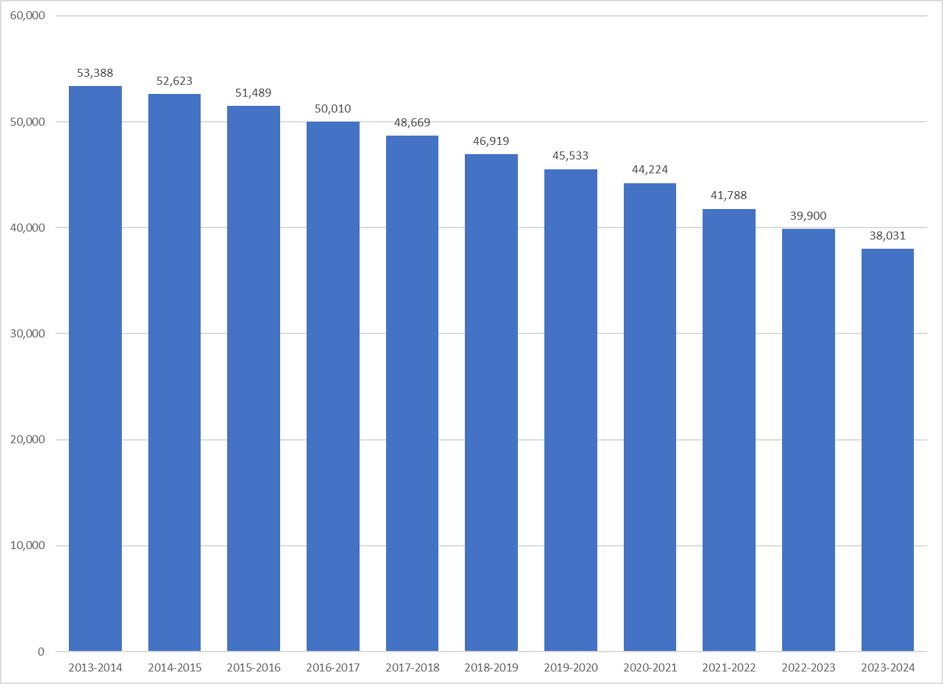
Sources
2013-2014 –> 2022-23: CDE DataQuest
2023-2024: Uncertified CALPADS Submission
Includes ALA
Enrollment, ADA, and Funded ADA
Notes:
Here is a quick look at our overall enrollment since 2013-2014; since that time we have lost almost 29% of our students. That is sobering, and we do need to stay focused on this,
However, from a funding standpoint, we are fortunate to have a hold harmless provision in place on ADA, and I want to spend some time going over the relationship between enrollment, ADA, and funded ADA..

Slide 9
Enrollment, ADA, and Funded ADA
Notes:
This slide shows the historical trends on enrollment, ADA, and Funded ADA
The purple line in the middle is enrollment…CBEDS info day, October. The red line on the bottom is average daily attendance, which is the average number of students actually in attendance from the first day of school to the end of the P2 attendance period, which is legally defined as the last school month ending on or before April 15 of a school year. For this school year, the P2 period ends on March 29.
Funded ADA is currently defined by statute as the greater of current year ADA or the average of the three prior years of ADA. We call this the hold harmless provision
This is incredibly helpful for a District like Santa Ana that is experiencing severe declines in enrollment; and our financial situation would be much worse if not for the ADA hold harmless.
This slide has a lot of numbers on it, so lets take a look at some simplified slides that show how the HH works.

Slide 10
2023-2024
Enrollment, ADA, and Funded ADA
Notes:
For the current year, our CBEDS info day enrollment was 37,663, the number in the purple shaded rectangle in the middle
We are projecting our P2 ADA to be 35,460, the number in the red shaded rectangle on the bottom right.
Now, if we move the ADA numbers in the red shaded rectangles in the three prior years…

Slide 11
2023-2024
Enrollment, ADA, and Funded ADA
Notes:
…and then calculate the average of those three years’ ADA..

Slide 12
2023-2024
Enrollment, ADA, and Funded ADA
Average = 40,001
Notes:
We see that the average in 40,001, which is our funded ADA.

Slide 13
2024-2025
Enrollment, ADA, and Funded ADA
Notes:
For 2024-2025, the ADA is projected to be 34,233…but the

Slide 14
2024-2025
Enrollment, ADA, and Funded ADA
Average =
Notes:
…funded ADA, the average of the three prior years is 37,293…and

Slide 15
2025-2026
Enrollment, ADA, and Funded ADA
Notes:
For 2025-2026, the projected ADA is 33,070…but…

Slide 16
2025-2026
Enrollment, ADA, and Funded ADA
Notes:
funded ADA, the average of the three prior years is 35, 403.
Once again, we are very fortunate, in the face of severe declining enrollment, to have this hold harmless; and our financial position would be much worse without the hold-harmless.
Turning our attention from ADA to actual revenue…

Slide 17
Revenue
Variances
LCFF
Increased UPP
Other State
Special Education
After School Education and Safety (ASES)
Other Local
Medi-Cal billing
Notes:
Here is the current year revenue.
For each of these slides, we will show what the approved budget was at the time of unaudited actuals, back in September

Slide 18
Revenue
2023-2024 Revenue
Notes:
Here is graphical rep of all revenue sources
Green and Purple still bigger due to COVID Relief
But LCFF still makes up the lion’s share of our revenue
Which makes…

Slide 19
LCFF Revenue
Notes:
…this slide very important.

Slide 20
Revenue
←Actuals
Projections→

Slide 21
COVID Relief Grant Funds

Slide 22
COVID Relief Grant Funds

Slide 23
COVID Relief Grant Funds

Slide 24
COVID Relief Grant Funds
← Actuals
Scenario (Projection) →

Slide 25
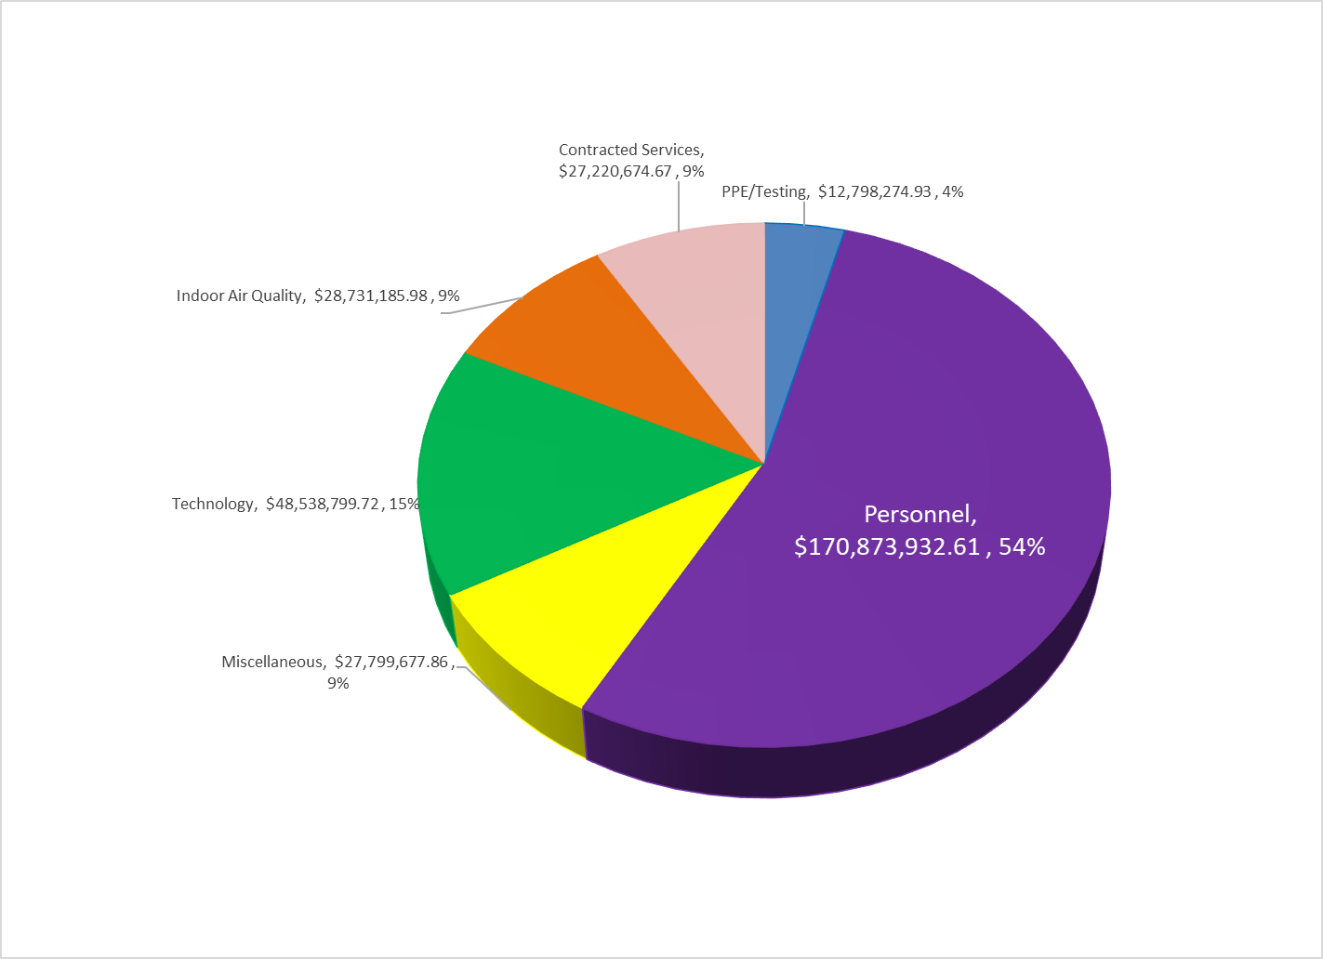
COVID Relief Grant Funds

Slide 26
Enrollment Trend Line
COVID Relief Grant Funds
46,919
45,533
44,224
41,788
39,900
38,031

Slide 27
Expenditures

Slide 28
Salaries & Benefits
Variances
Certificated
Unfilled vacant positions
Extra duty
Classified
Filled vacancies
Special Education
Afterschool
Employee Benefits
Increased employer contribution rates
Health & Welfare
Retirement (medical)

Slide 29
Salaries & Benefits
← Actuals
Projections→
Notes:
Pause:
Trendline

Slide 30
Supplies, Services, & Capital Outlay
Variances
Supplies
Based on Prior Year Patterns
Services
Contracted staffing
Expanded learning projects
Capital Outlay
Expanded learning capital projects

Slide 31
Supplies, Services, & Capital Outlay
← Actuals
Projections→

Slide 32
Expenditures
Salaries & benefits account for 79% of
District expenditures ($722M of the $911M)

Slide 33
Total Revenue & Expenditures
Variances
LCFF
Increased UPP
Other State
Special Education
After School Education and Safety (ASES)
Other Local
Medi-Cal billing
Variances
Certificated
Unfilled vacant positions & Extra duty
Classified
Filled vacancies: Special Education & Afterschool
Employee Benefits
Employer contribution rates: H&W & Retirement
Supplies
Based on Prior Year Patterns
Services
Contracted staffing
Expanded learning projects
Capital Outlay
Expanded learning capital projects

Slide 34
Total Revenue & Expenditures
← Actuals
Projections→

Slide 35
Ending Fund Balance
← Actuals
Projections→
Notes:
361.3 vs 375.8 M
264.2 vs 298.5 M
181.5 vs 264.2 M

Slide 36
Ending Fund Balance
Notes:
counterclockwise

Slide 37
Next Steps
May Revise
2024-2025 LCAP/Budget Development
Continued Budget Discussions

Slide 38
Budget Timeline
Notes:
May revision informs the budget

Slide 39
Budget Discussions

Slide 40
Thank you!
Questions?

